Slide 1
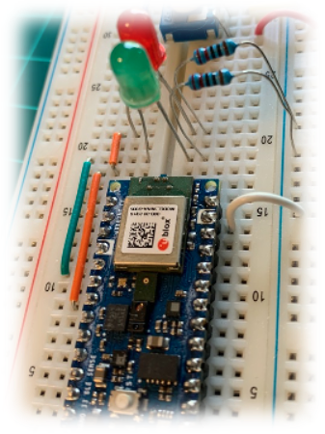

IESTI01 – TinyML
Embedded
Machine Learning
Collecting Data
with Edge Impulse Studio
Prof. Marcelo Rovai
UNIFEI

Slide 2
Sensor Data – EI Studio Ingestion Alternative methods

Slide 3
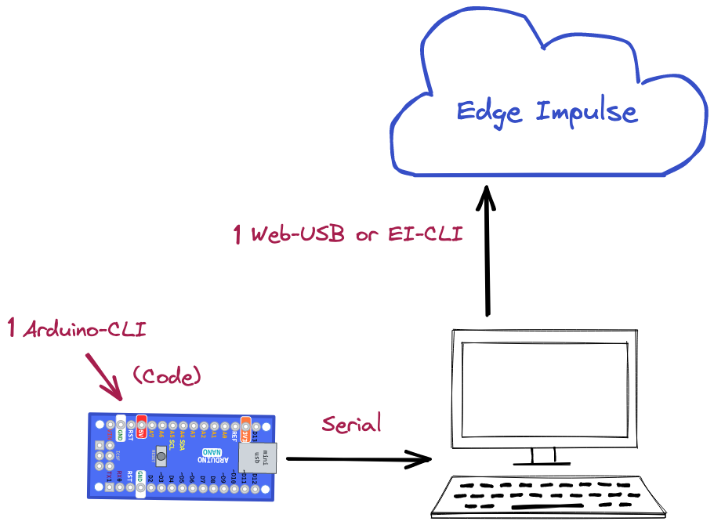


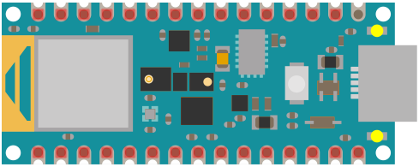
1.

Slide 4
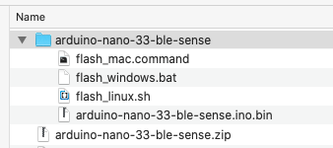
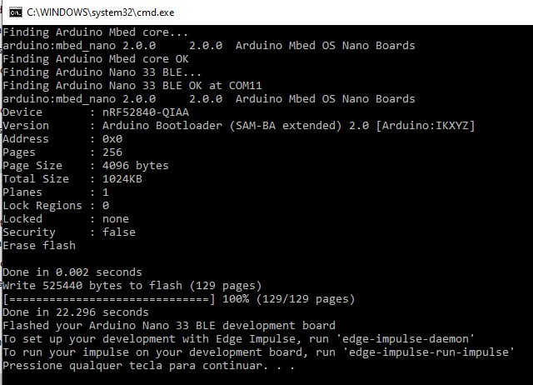
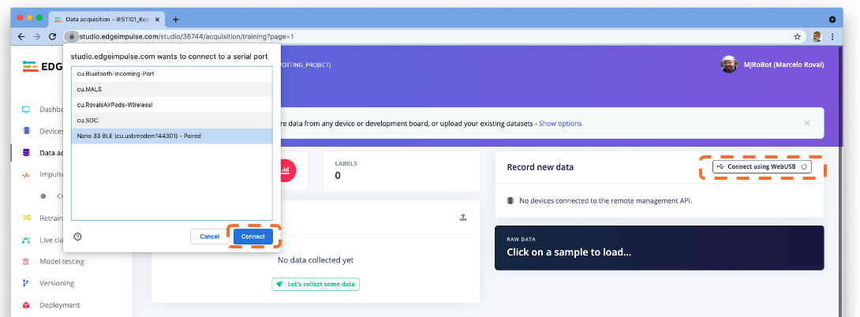
1. Data Ingestion using Arduino-Cli + Web-USB (or EI-CLI)
Installing the Arduino CLI on Windows 10

Slide 5
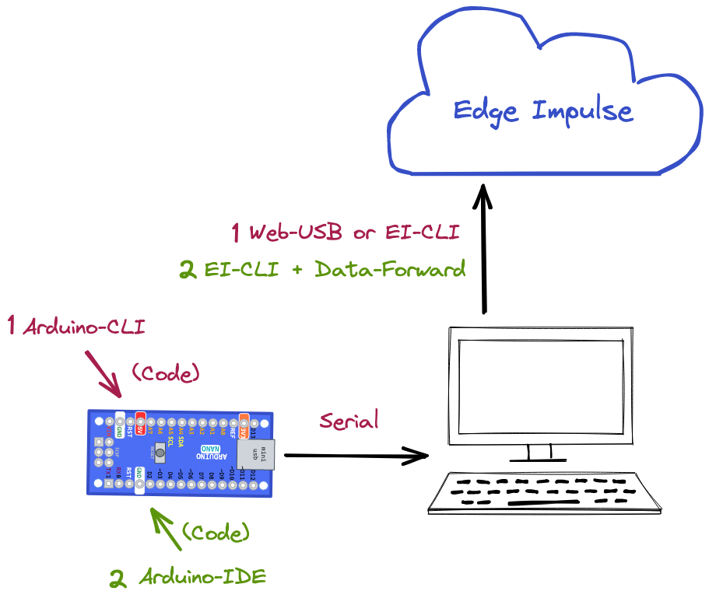

2.

Slide 6
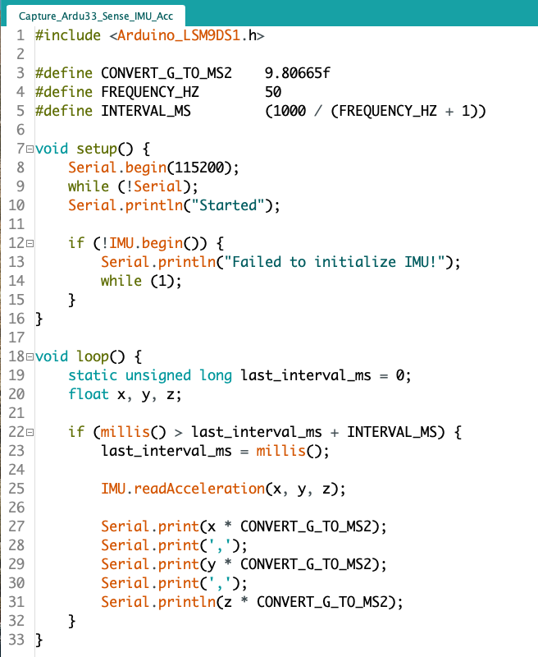
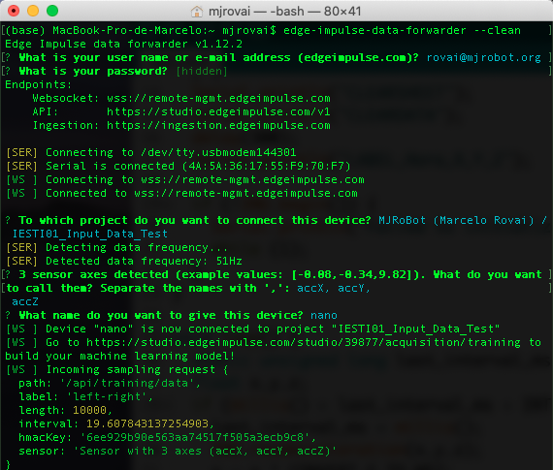
2. Data Ingestion using EI-Cli + Data Forward
$ edge-impulse-data-forwarder --clean

Slide 7
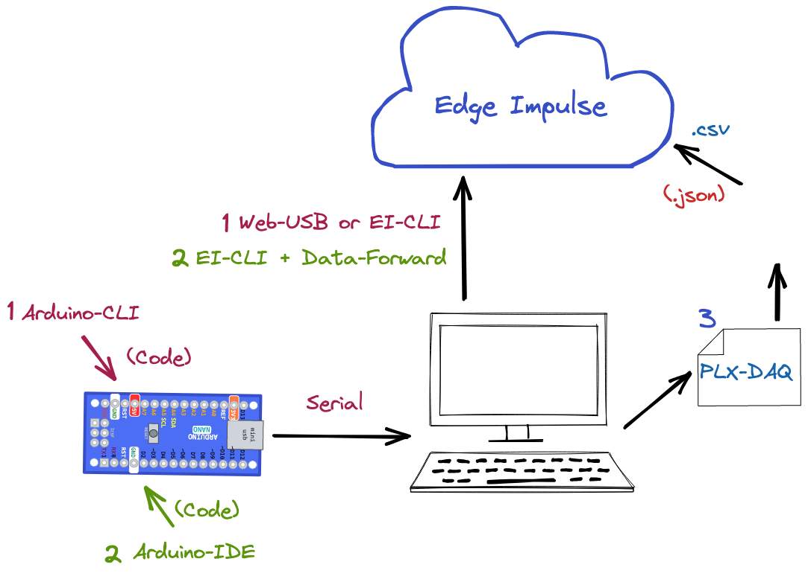
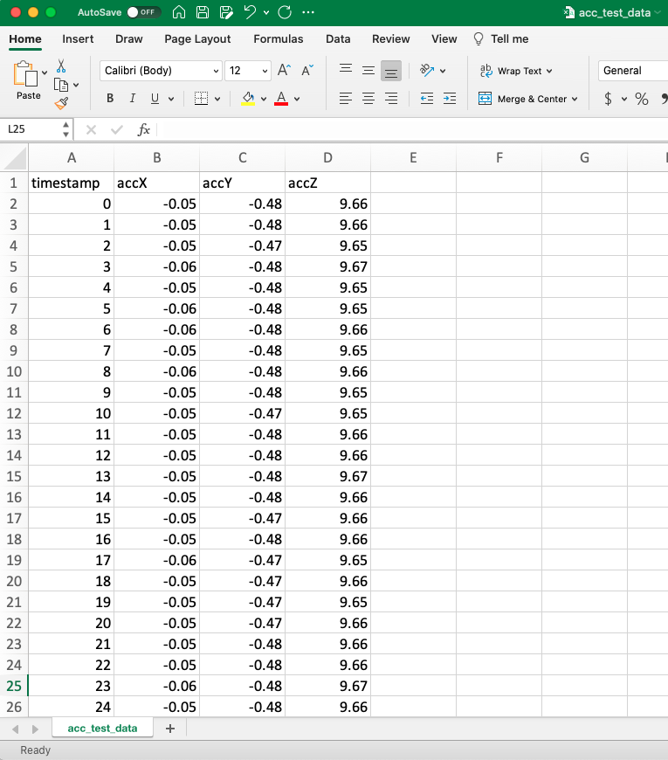
3.

Slide 8
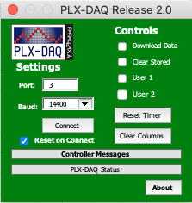
3. Data Ingestion using PLX-DAQ (Windows) => Final Format: .csv

Slide 9
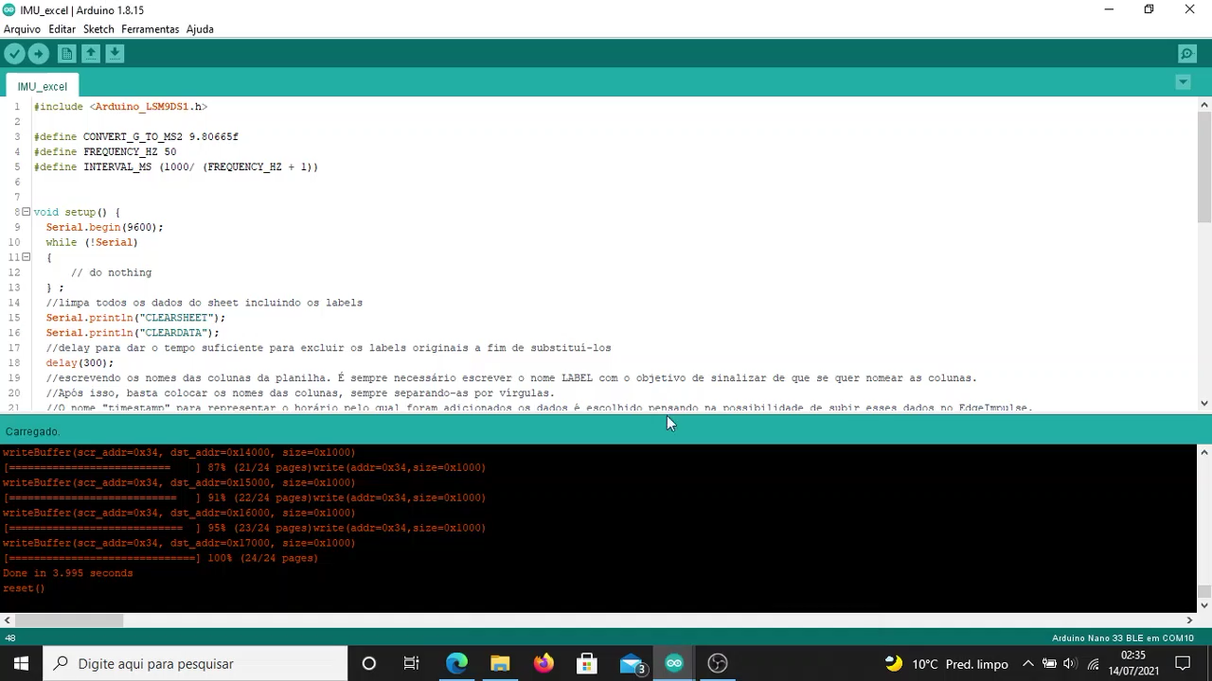
3. Data Ingestion using PLX-DAQ (Windows) => Final Format: .csv
https://www.youtube.com/watch?v=BwbmNle2CZo

Slide 10
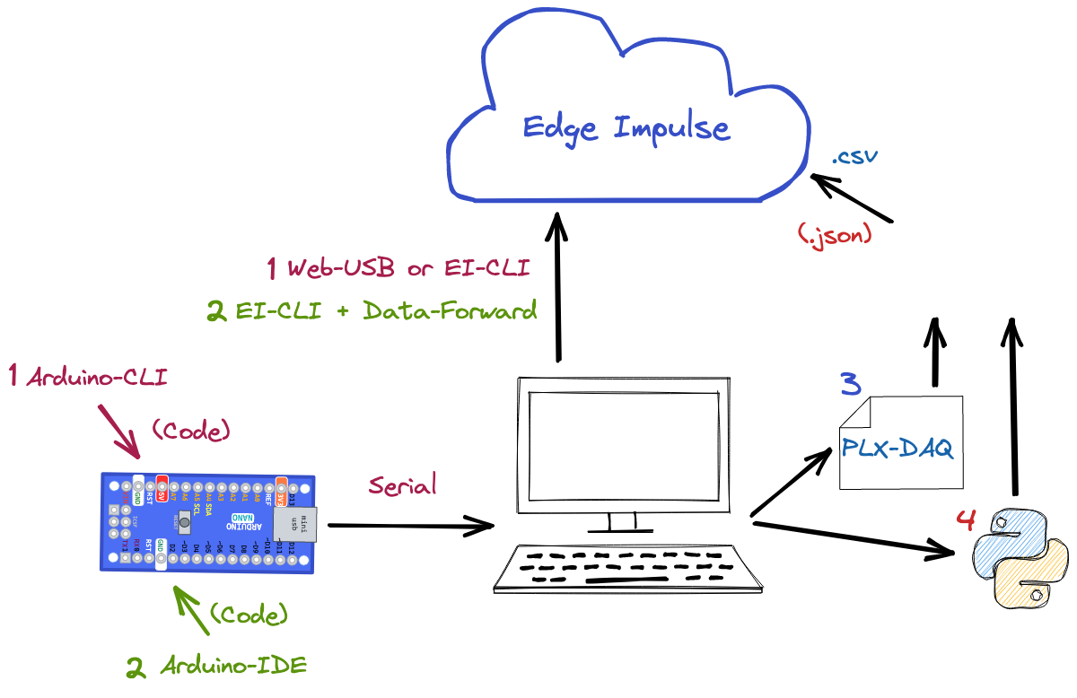
4.

Slide 11
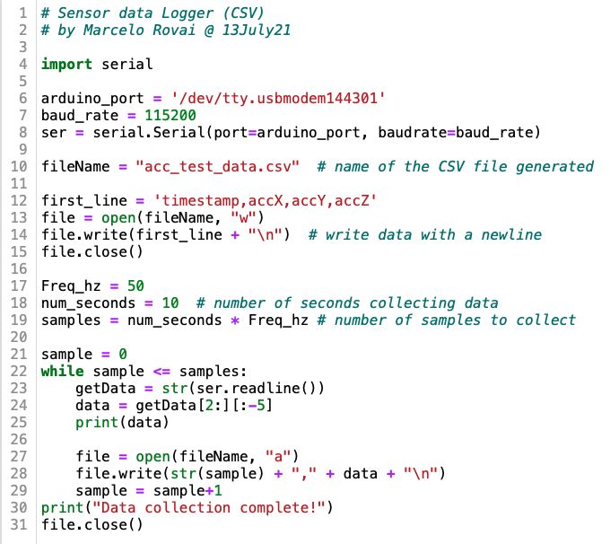
4. Data Ingestion using Python (PySerial) => Final Format: .csv

Slide 12
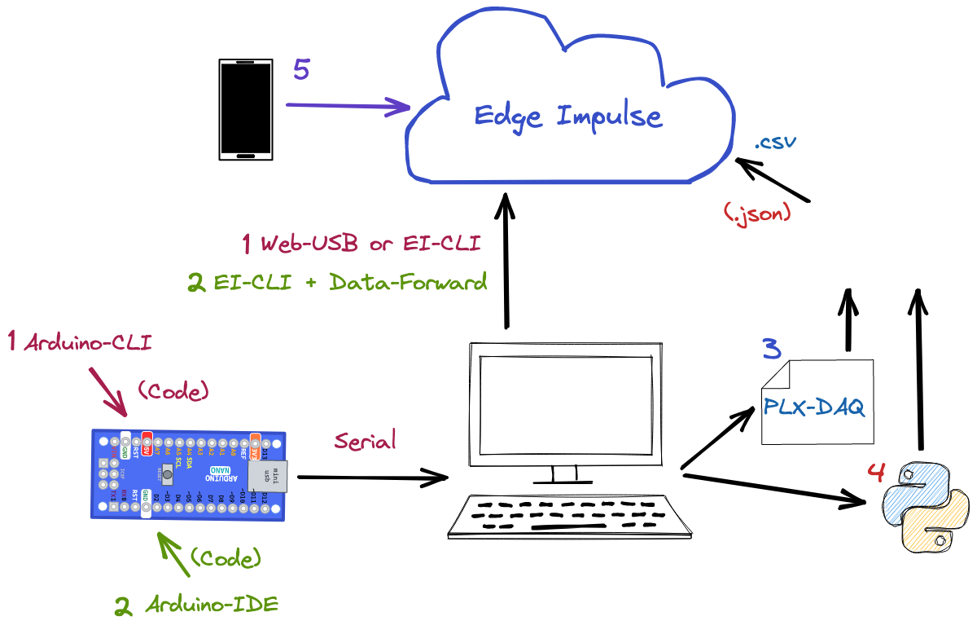
5.

Slide 13
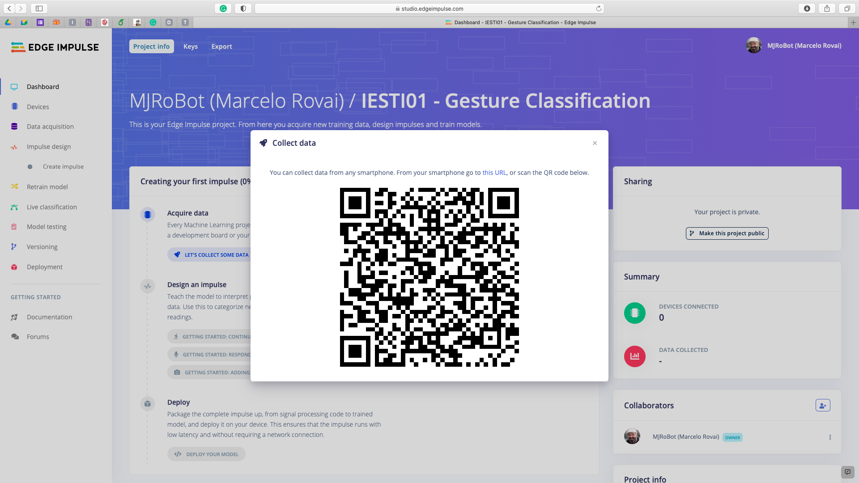
5. Data Ingestion using Smart Phone

Slide 14
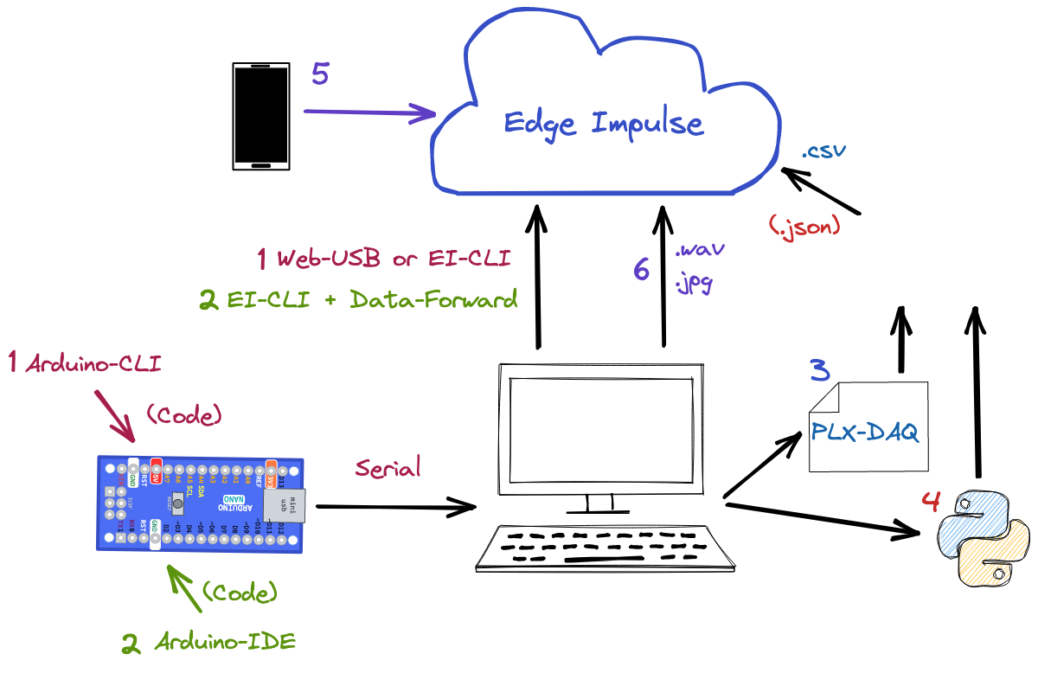
6.

Slide 15
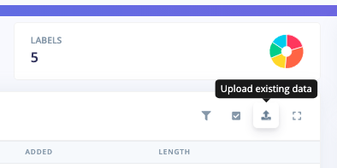
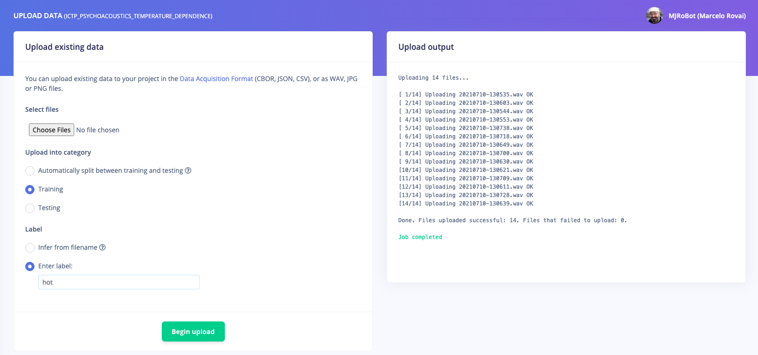
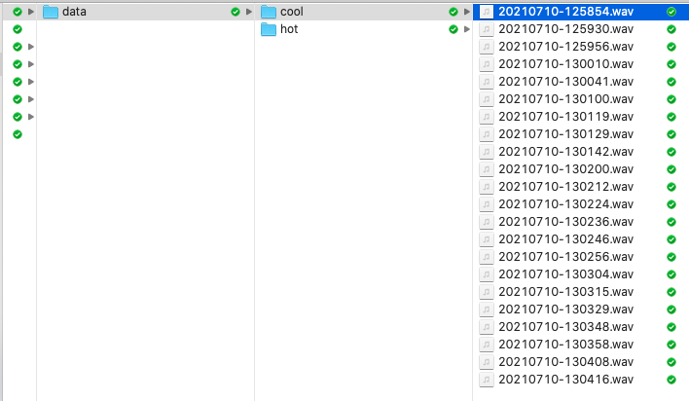
6. Data Ingestion using Upload existing Data
(CBOR, JSON, CSV), or as WAV, JPG or PNG files.

Slide 16
Data Ingestion
Summary

Slide 17
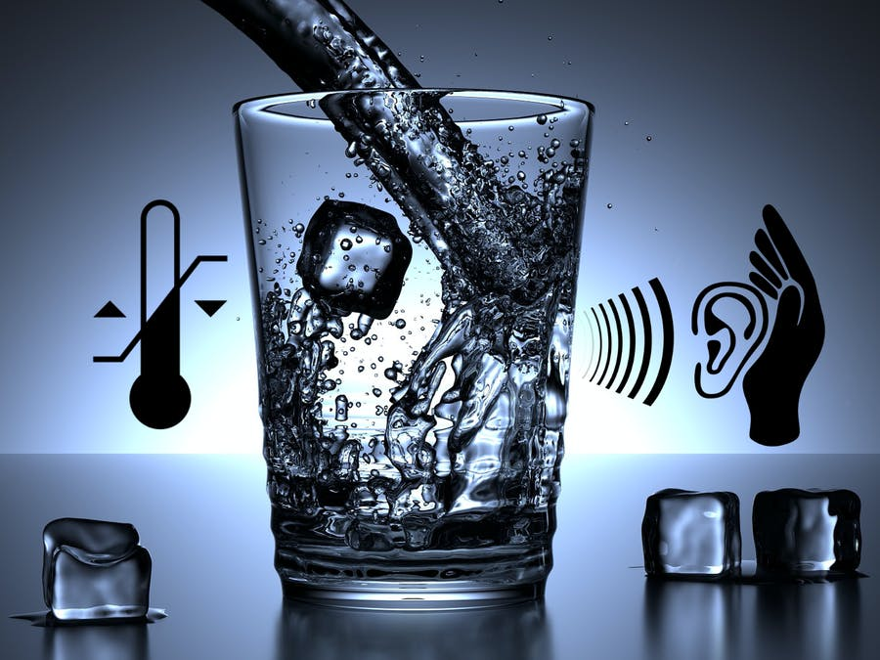
Temperature Dependence Psychoacoustics
Simple TinyML Proof-of-concept
https://www.hackster.io/mjrobot/listening-temperature-with-tinyml-7e1325

Slide 18
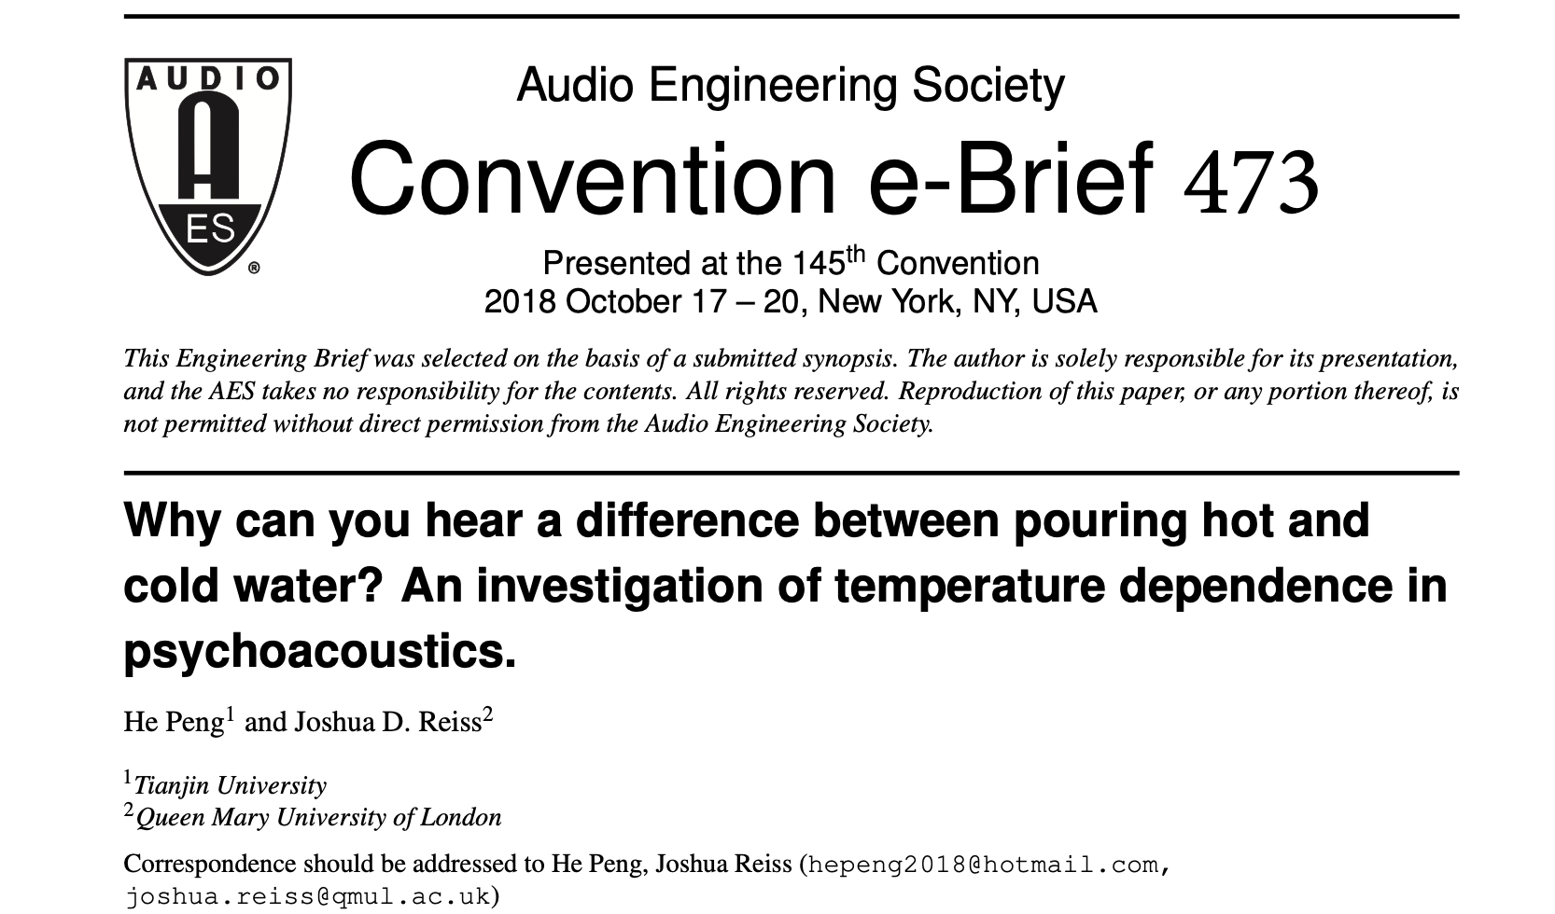
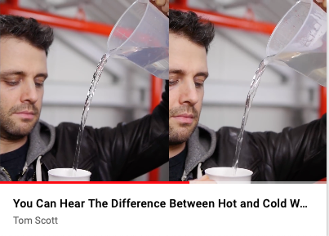
http://www.eecs.qmul.ac.uk/~josh/documents/2018/19737.pdf
https://www.youtube.com/watch?v=Ri_4dDvcZeM
(min: 0.17 => min 2:37)

Slide 19
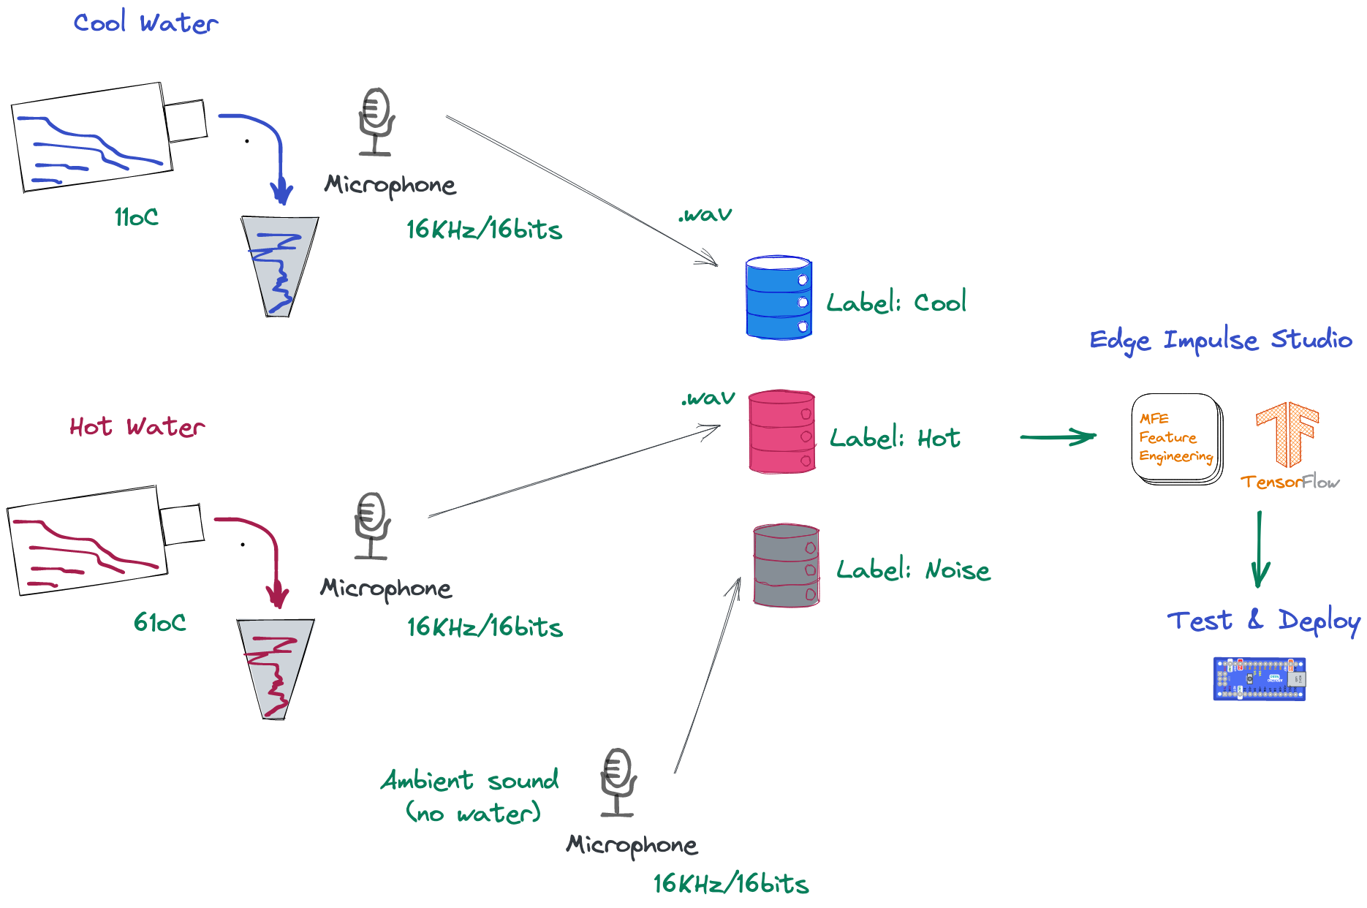
Experiment Overview

Slide 20
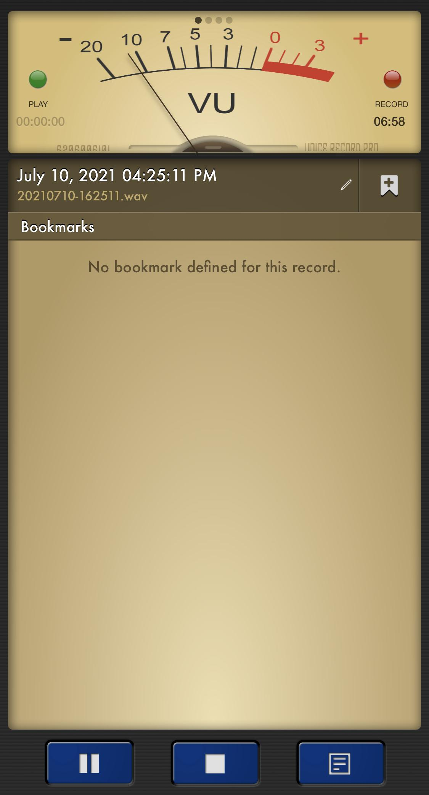

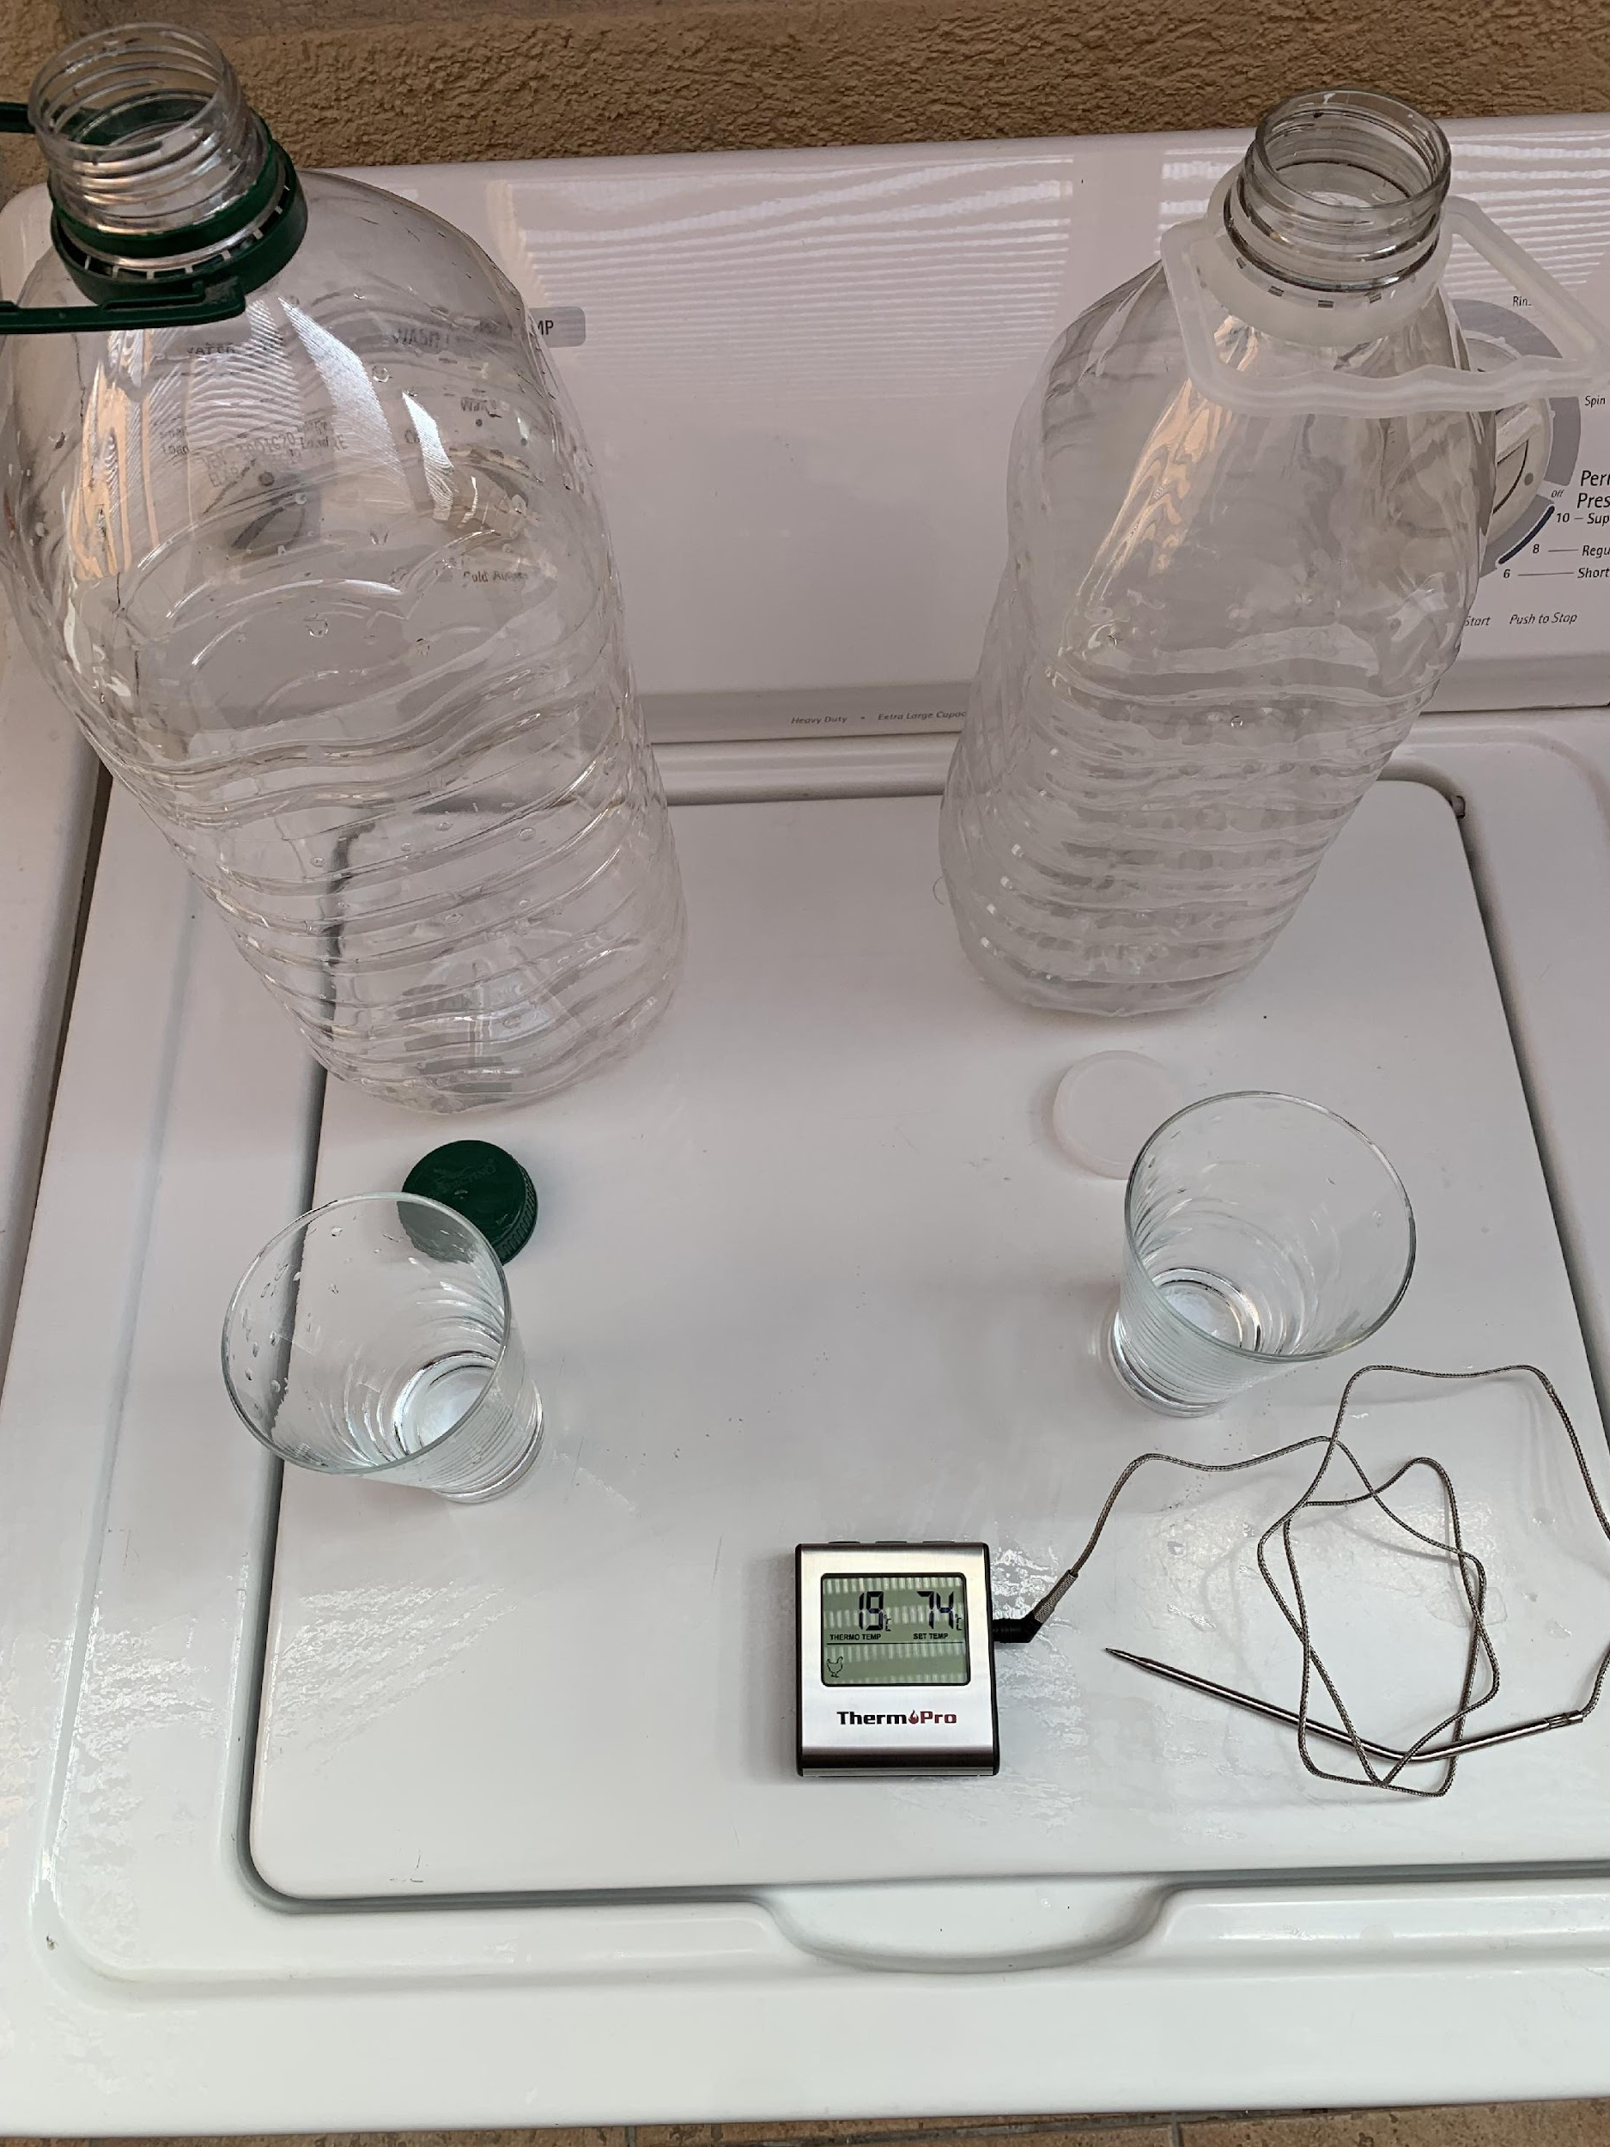
Voice Recorder
Sample Sound:
16KHz
PCM – 16bits
Mono
Classes:
Hot
Cool
Noise
Ambient Temperature: 19ºC

Slide 21
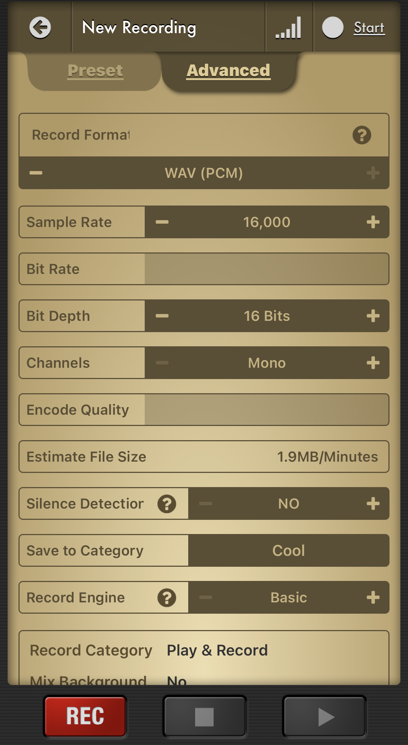
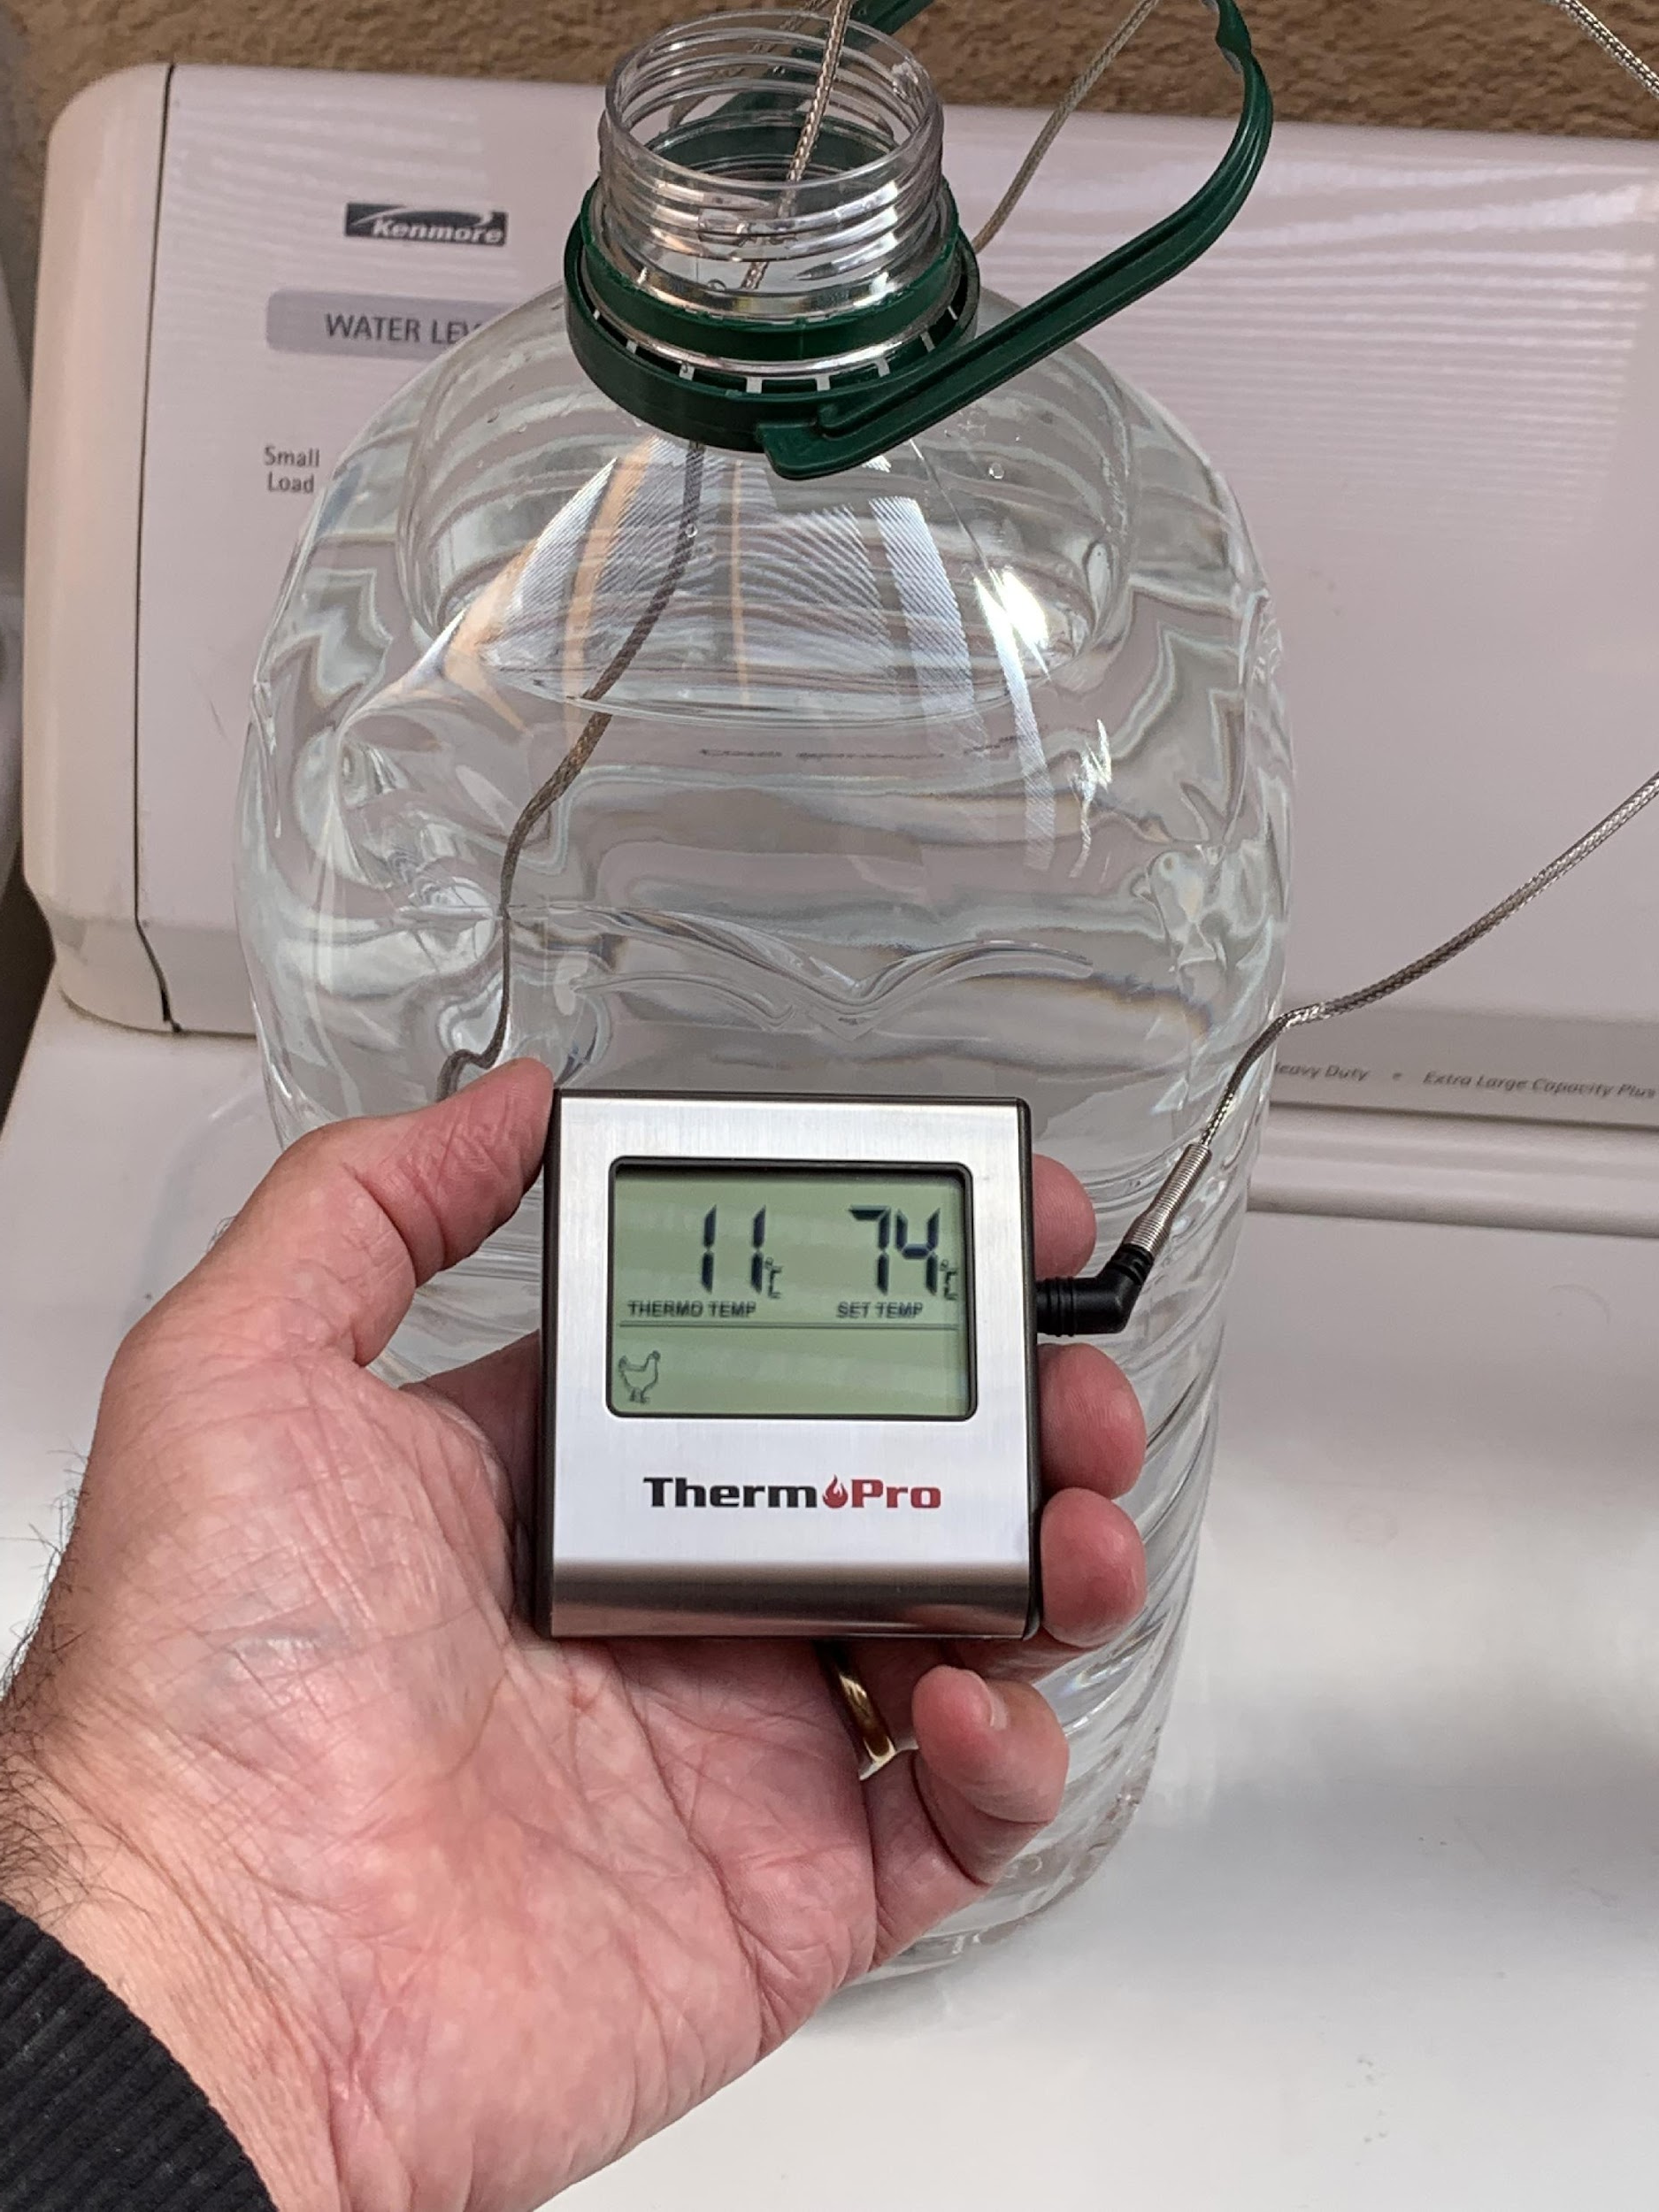
Class: Cool
Cool Water Temperature: 11ºC

Slide 22
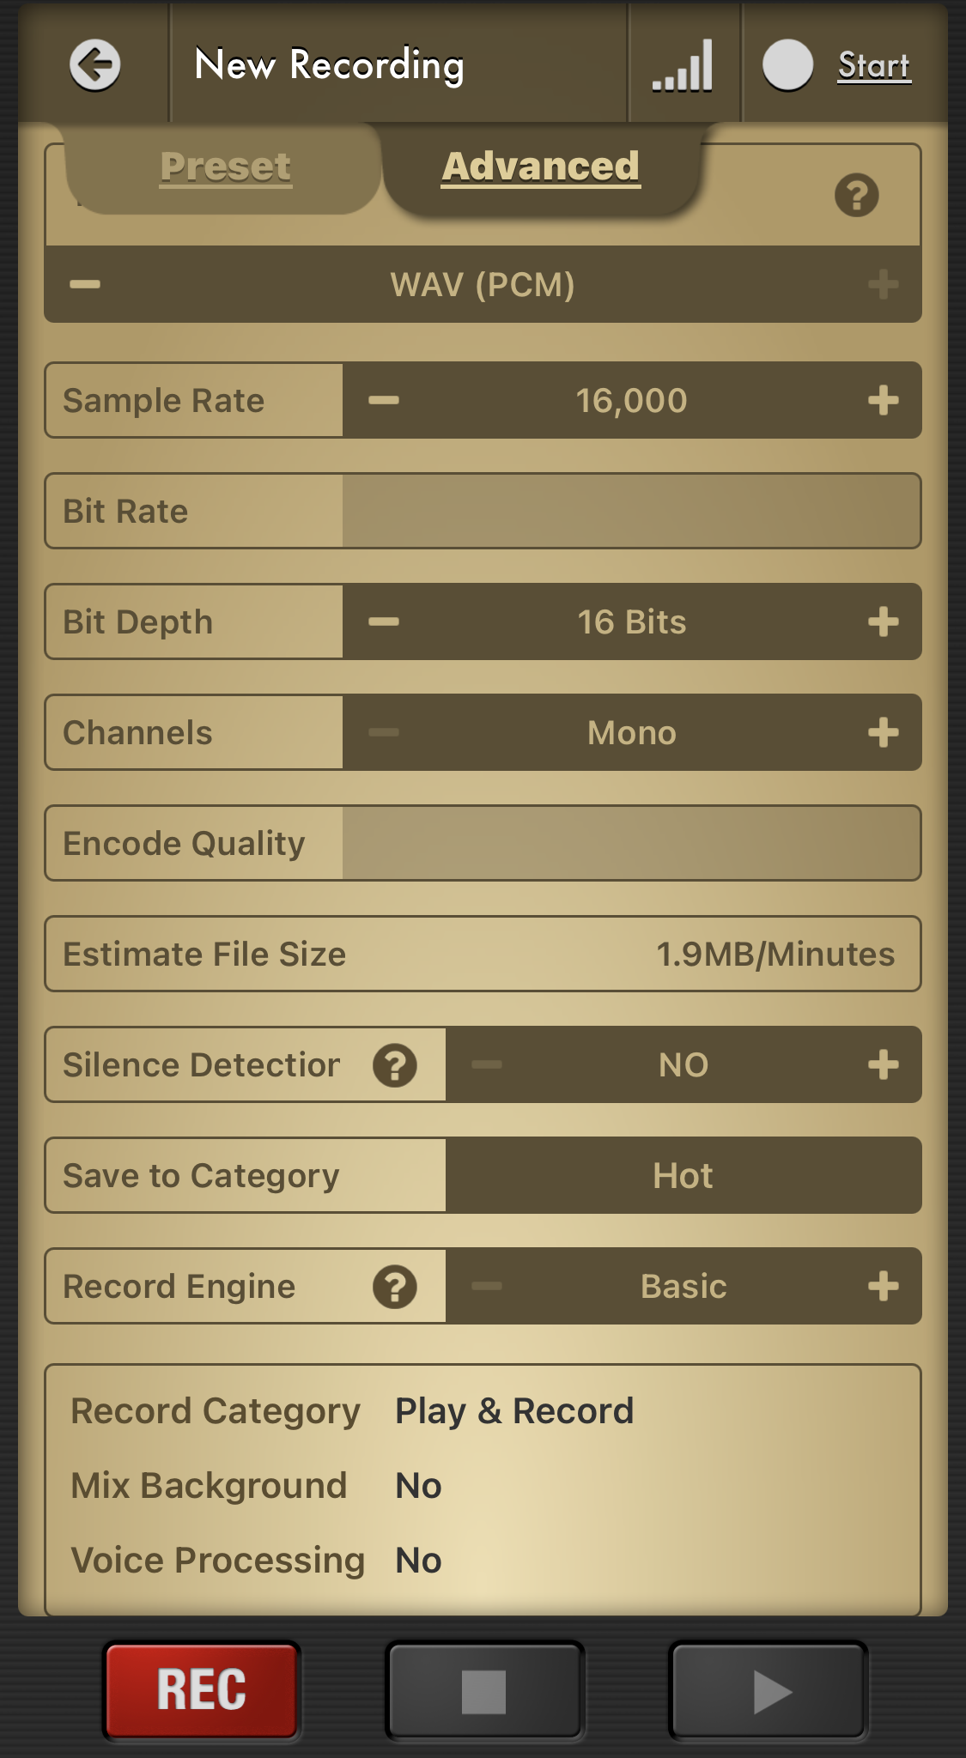
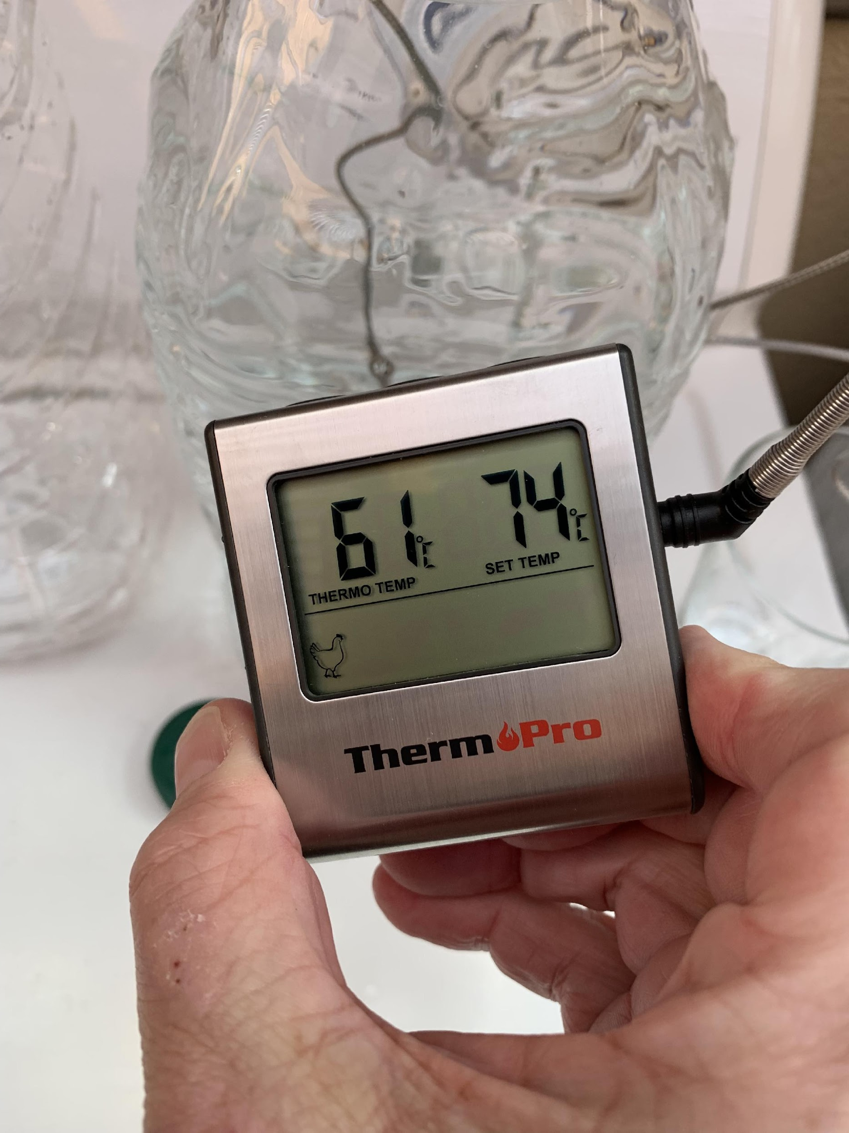
Class: Hot
Hot Water Temperature: 61ºC

Slide 23
Data captured using app Voice Recorder and uploaded to Computer

Slide 24
Raw Data uploaded to Edge Impulse Studio as .wav

Slide 25
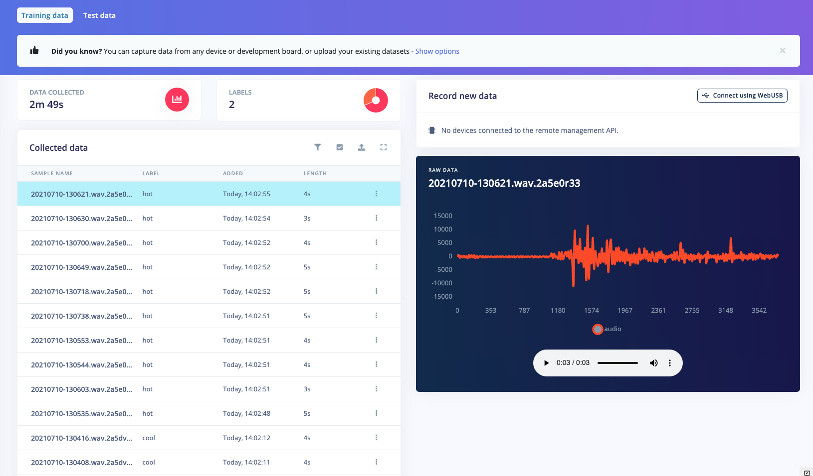
Raw Data cleaned as split in 1 second samples

Slide 26
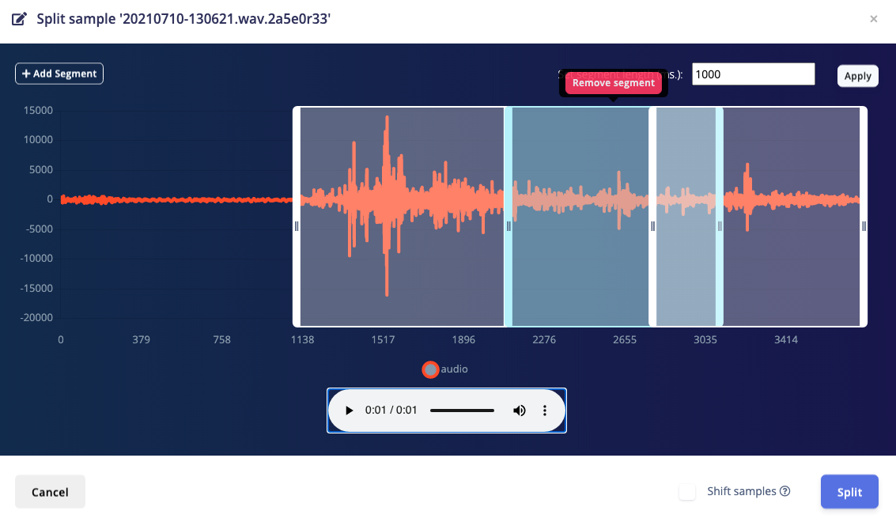
Raw Data cleaned as split in 1 second samples

Slide 27
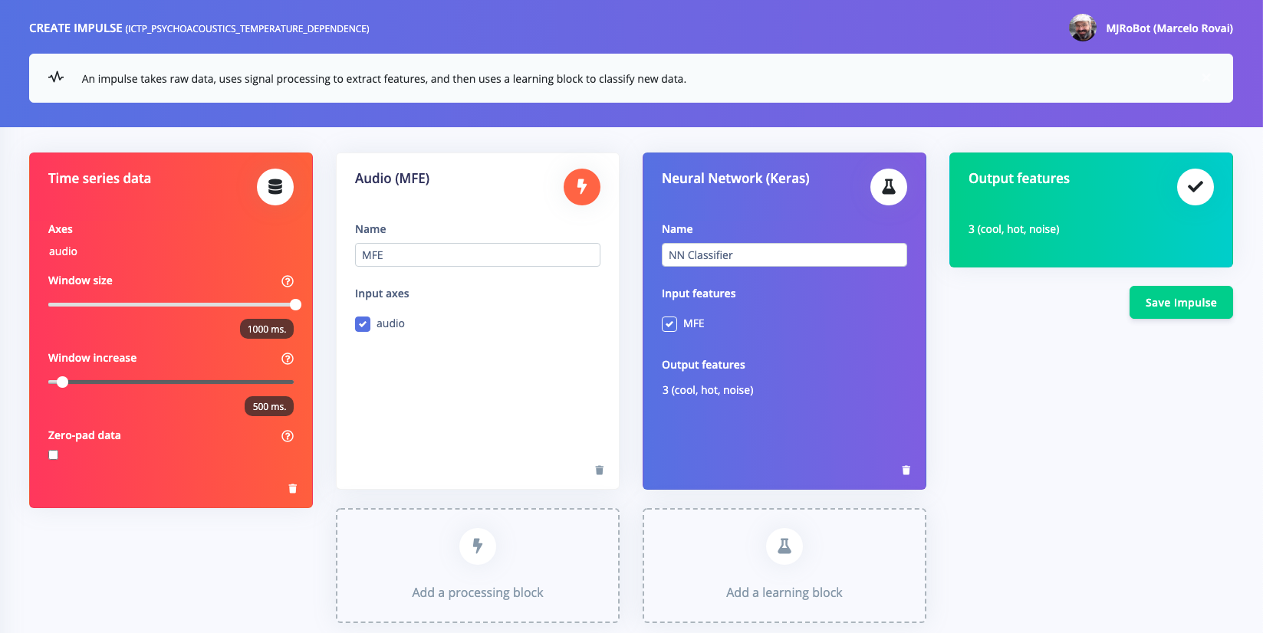
Audio (MFE)
Extracts a spectrogram from audio signals using Mel-filterbank energy features, great for non-voice audio.

Slide 28
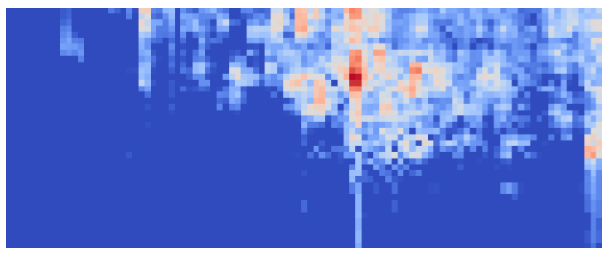
Cool Water 1 second sample

Slide 29

Hot Water 1 second sample

Slide 30

Noise 1 second sample

Slide 31
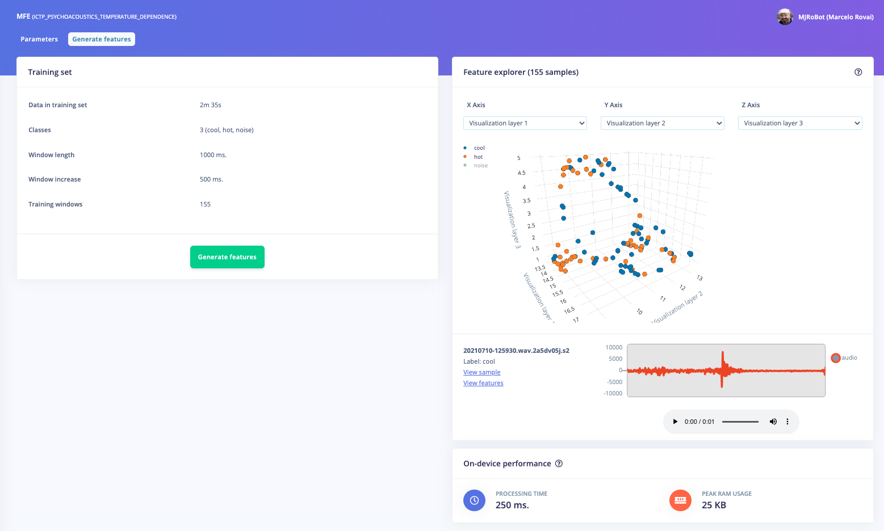

Slide 32
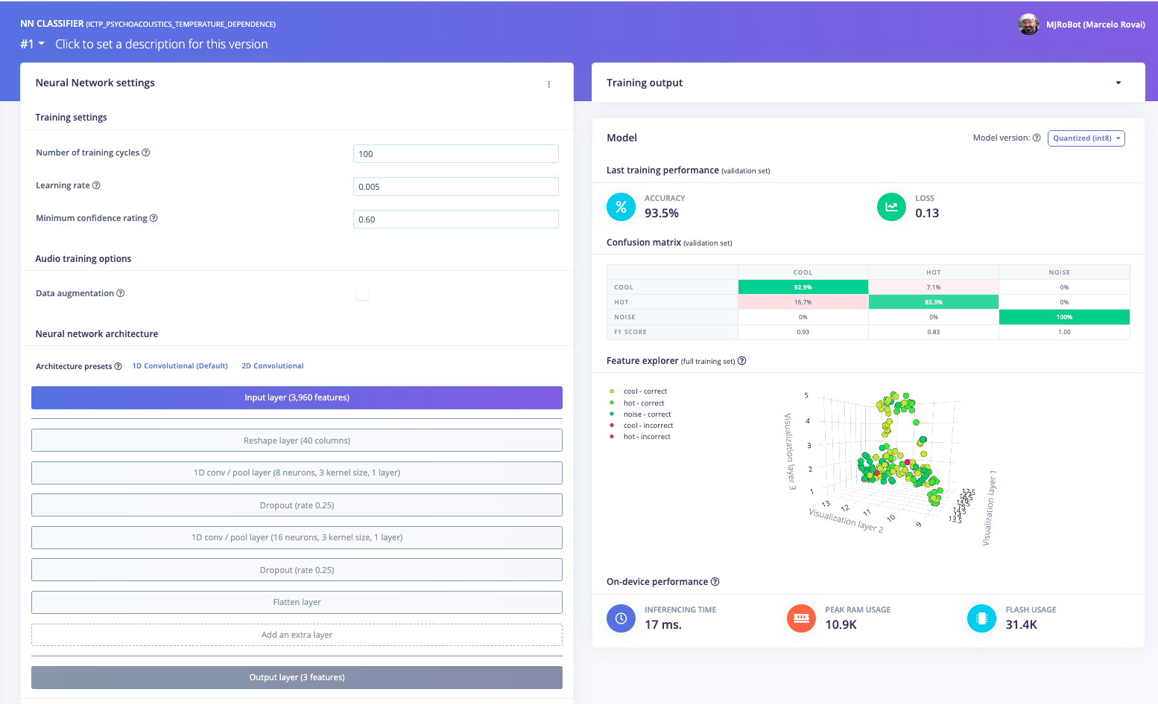

Slide 33
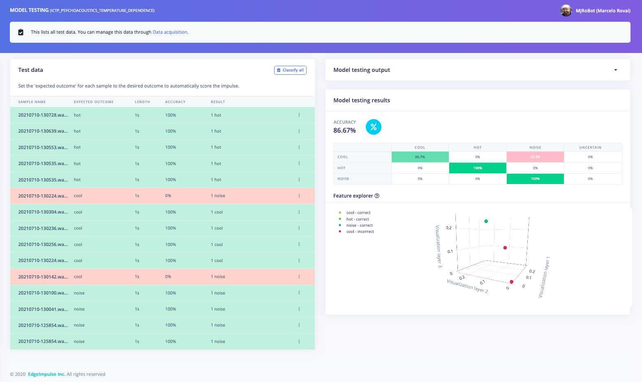

Slide 34
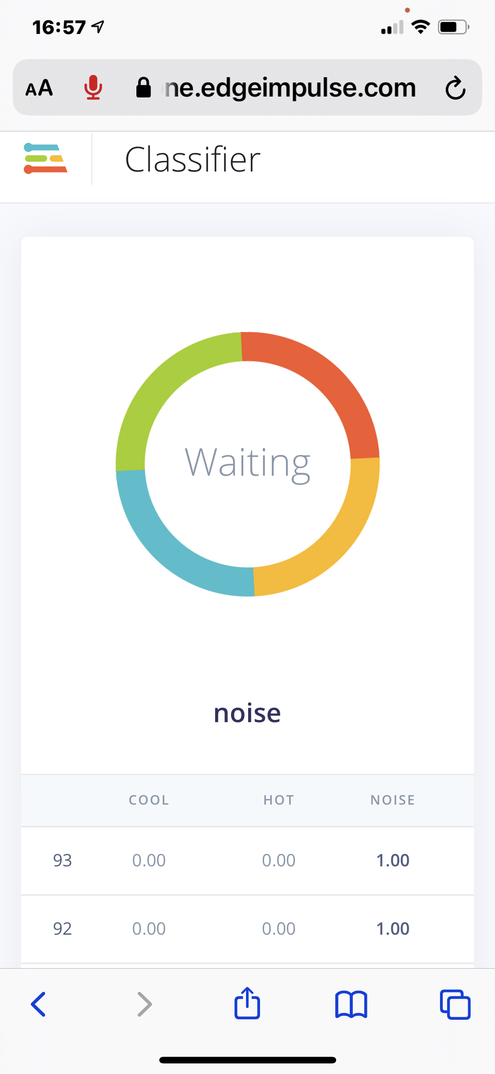
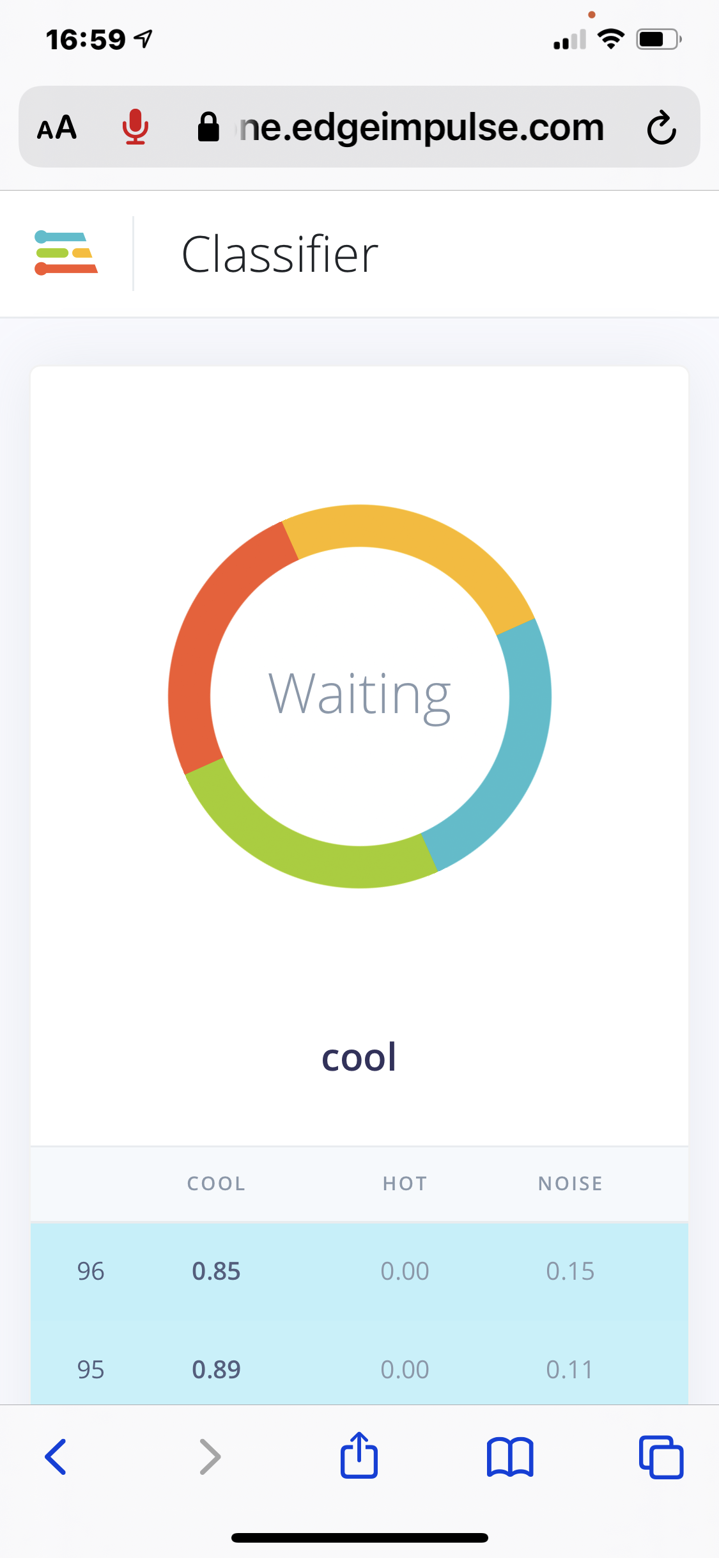
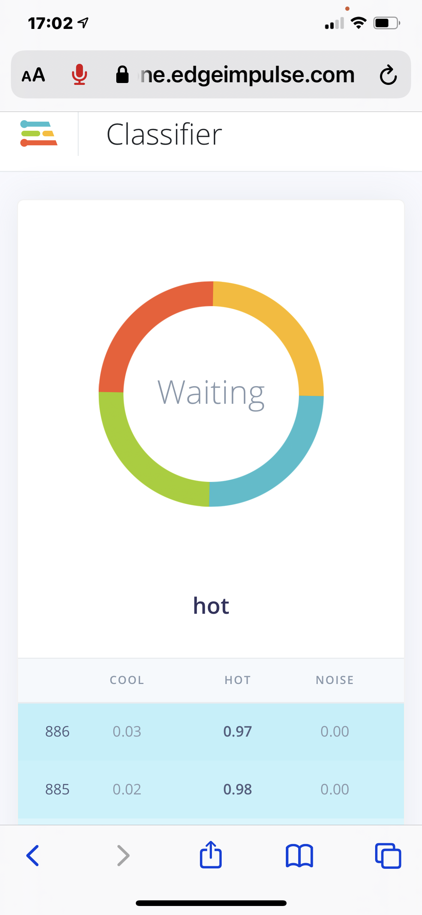
Live Classifier (Off line) using iphone

Slide 35
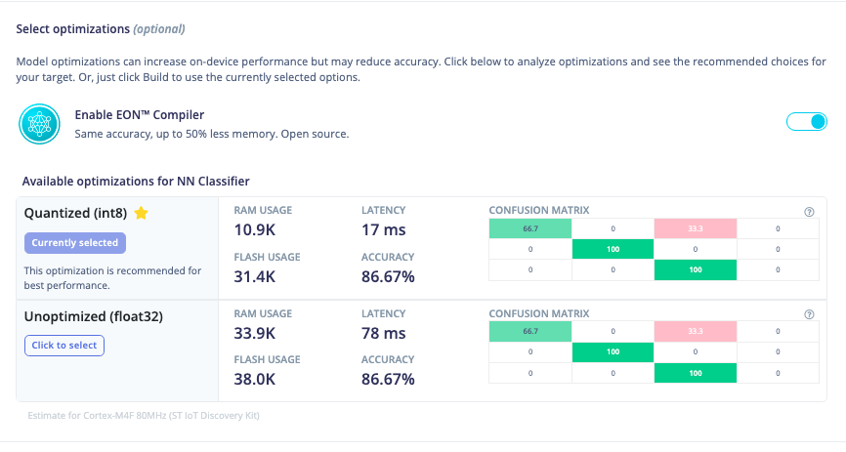

Slide 36
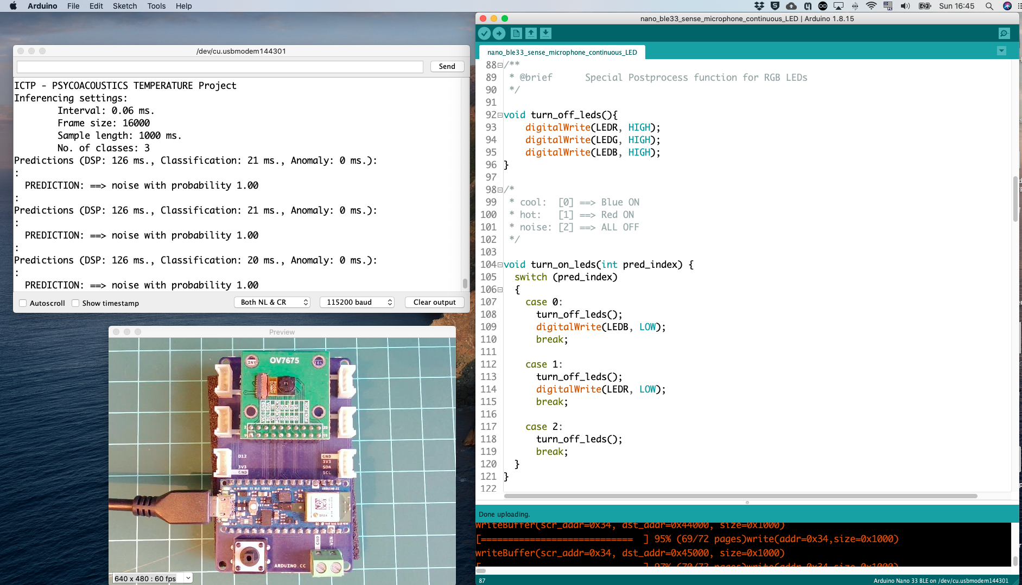

Slide 37
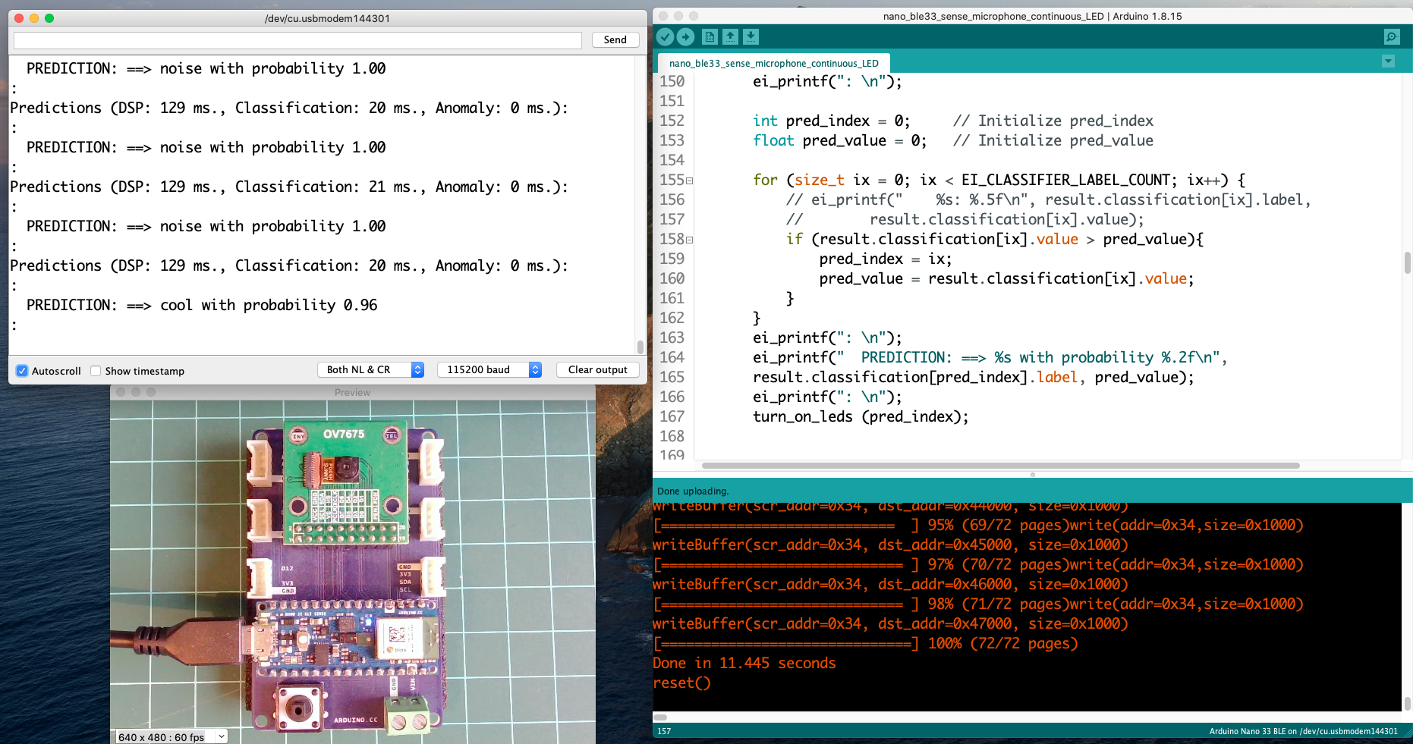
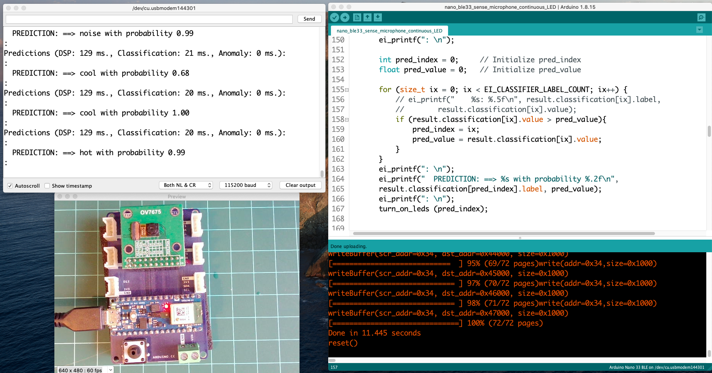
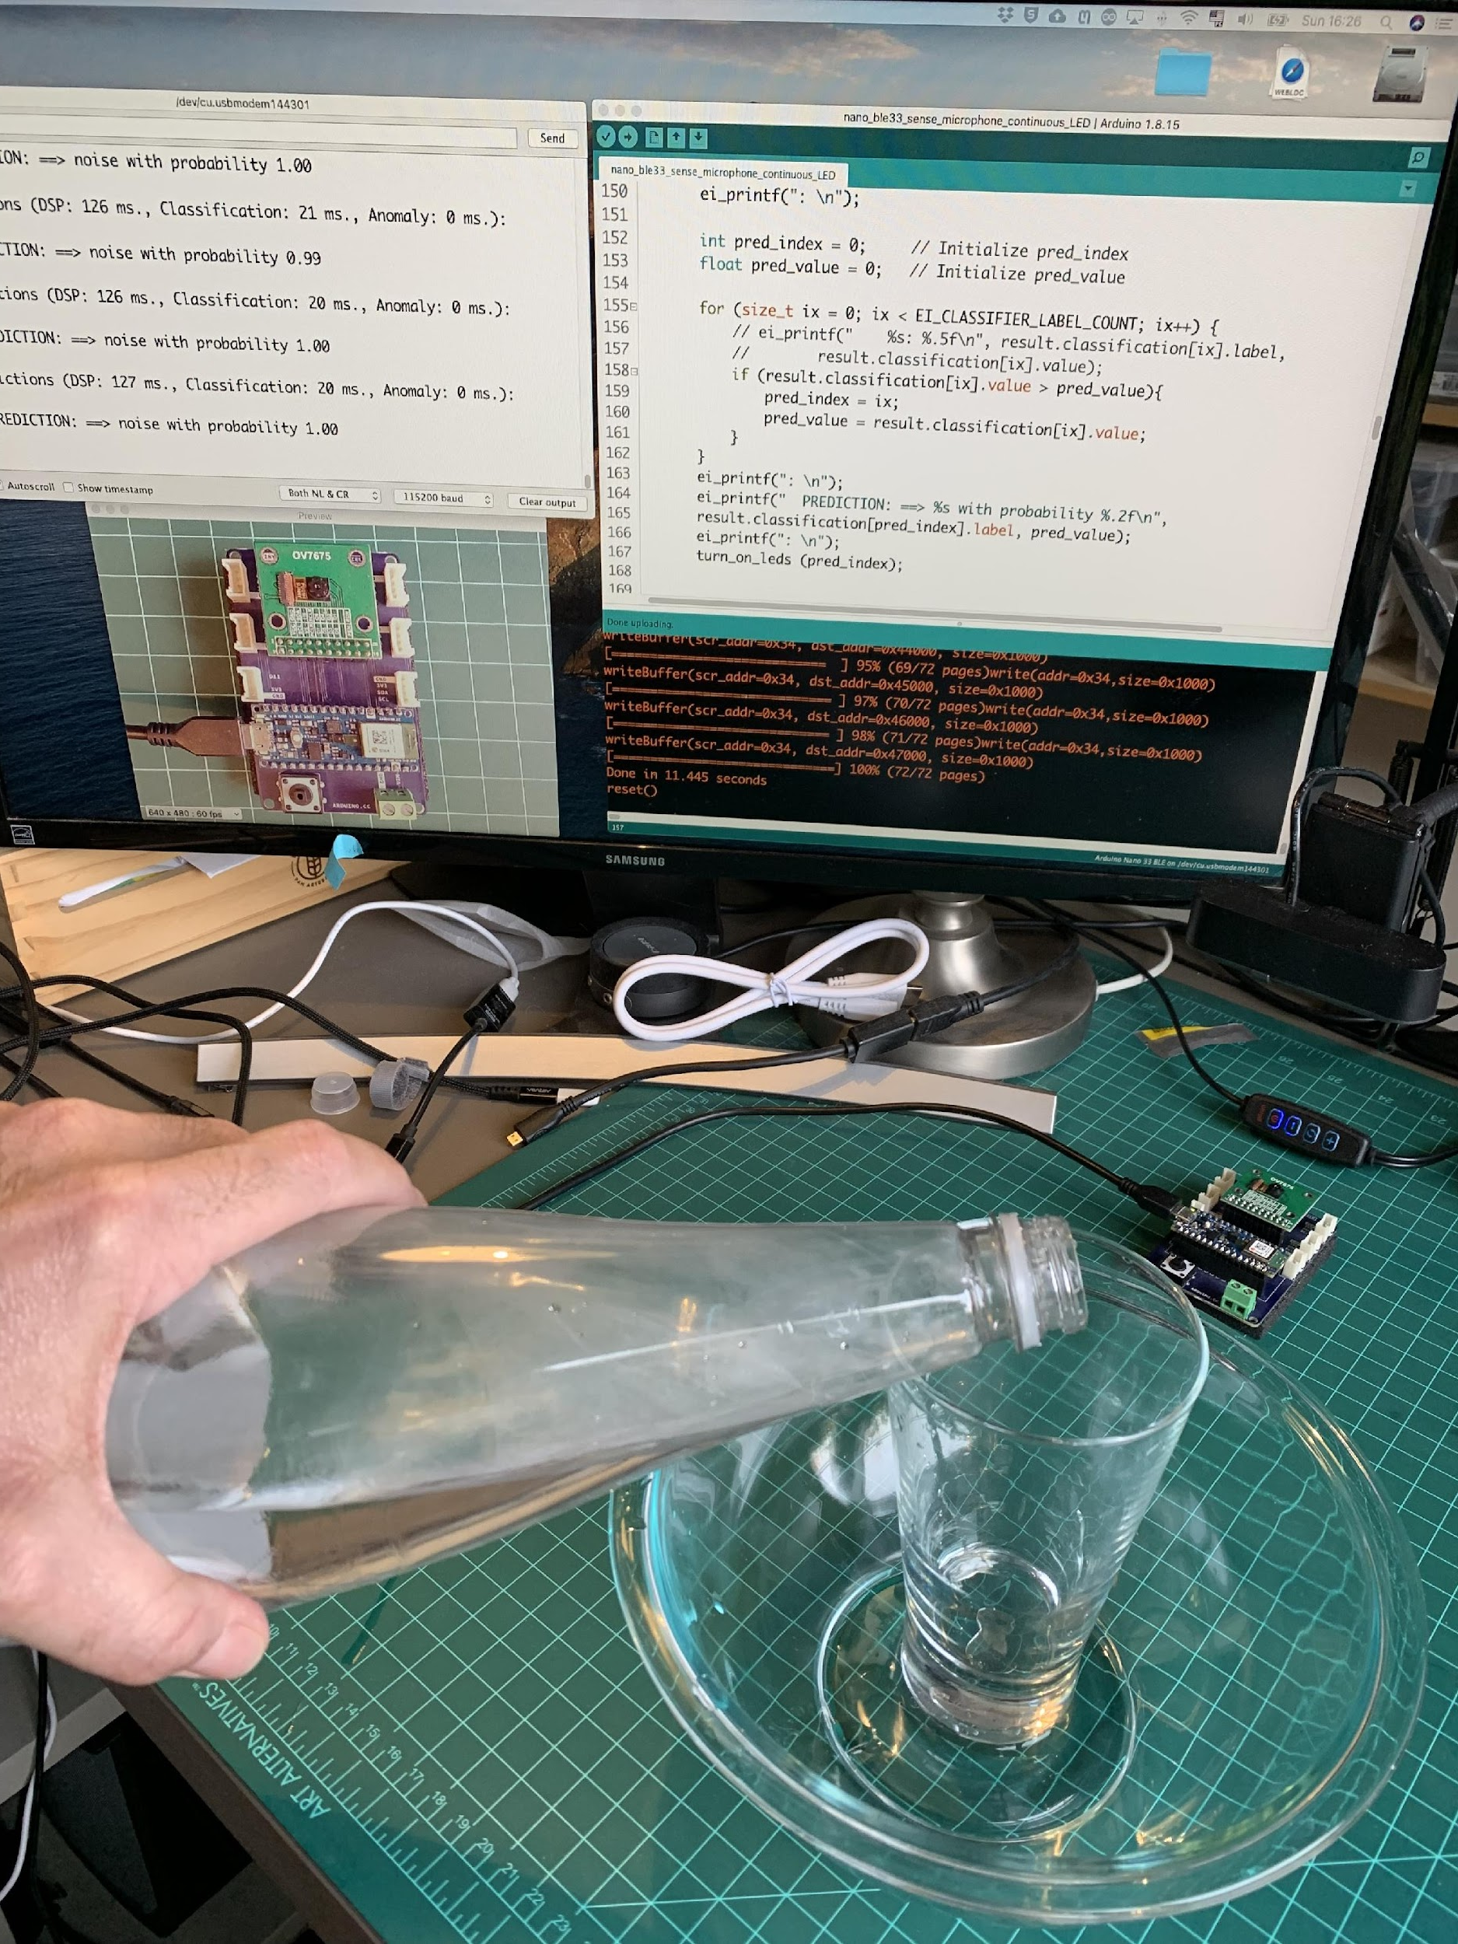

Slide 38
Reading Material

Slide 39
Main references
Harvard School of Engineering and Applied Sciences - CS249r: Tiny Machine Learning
Professional Certificate in Tiny Machine Learning (TinyML) – edX/Harvard
Introduction to Embedded Machine Learning (Coursera)
Text Book: "TinyML" by Pete Warden, Daniel Situnayake
I want to thank Shawn Hymel and Edge Impulse, Pete Warden and Laurence Moroney from Google, and especially Harvard professor Vijay Janapa Reddi, Ph.D. student Brian Plancher and their staff for preparing the excellent material on TinyML that is the basis of this course at UNIFEI.
The IESTI01 course is part of the TinyML4D, an initiative to make TinyML education available to everyone globally.

Slide 40

Thanks
And stay safe!

